Slide 1
A GREAT SYNERGY: HOW PRIVATE FOUNDATIONS CAN BENEFICIALLY COLLABORATE WITH COMMUNITY FOUNDATIONS
California Community Foundation November 6, 2014
Jane Peebles, Esq. Karlin & Peebles, LLP

Slide 2
Private Foundation or Donor Advised Fund?
How does an advisor decide to recommend one or the other?
Advantages and disadvantages of each of these charitable grant making vehicles

Slide 3
What Is a Private Family Foundation?
Formed by a person, a couple or a family
Separate legal entity in corporate or trust form
Organized and operated exclusively for charitable, literary or educational purposes
Makes grants to other charities

Slide 4
Private Foundation Advantages: Control
Donor can play active role in foundation administration
Donor or family can control to whom, when and for what purposes grants are made
Donor controls foundation’s investments

Slide 5
Private Foundation: Donor Recognition
Donor or family’s name is on each check
Donor can deliver check

Slide 6
Private Foundation: Grantmaking
Make grants to U.S. 501(c)(3) public charities
Make grants directly to individuals facing hardship or emergencies
Support organizations outside the U.S.
Set up and run scholarship programs
Negotiate and monitor multi-year grants to fund longer term projects

Slide 7
Private Foundation Tax Benefits
Income tax deduction for lifetime gifts to foundation
Cash: Up to 30% of AGI
Appreciated publicly traded stock: FMV up to 20% of AGI
Other appreciated assets: cost basis up to 20% of AGI
5-year carry forward

Slide 8
Private Foundation Tax Benefits
Unlimited estate tax deduction for bequest to private foundation
Foundation itself is income tax exempt, subject to 2% excise tax on net investment gains

Slide 9
Private Foundations: Disadvantages
Required annual charitable grants of at least 5% of asset value regardless of actual income
Substantial legal, accounting and operational costs to establish and to terminate
Must establish and manage its own administration and operations

Slide 10
Private Foundations: Disadvantages
Must manage its own investments
Must file separate tax returns each year
Grant information readily available to public in foundation’s tax returns
Anonymity not possible

Slide 11
What Is a Donor Advised Fund?
A Donor Advised Fund (“DAF”) is a separate fund, usually in donor’s name
Established at public charity (typically community foundation) or commercial vendor
Donor and donor’s family serve as advisors to the public charity about where charitable grants from the DAF will go

Slide 12
Advantages of a DAF
No cost to donor to set up
Easy to establish
No separate IRS exemption application
Established by simple agreement with public charity sponsor

Slide 13
Advantages of a DAF: Easy to Maintain
Minimal ongoing annual administration costs
No separate tax returns or annual taxes
Investments provided by sponsoring charity, often with advice of donor
Lower minimum size

Slide 14
Advantages of a DAF: Donor and Family
Sponsoring public charity has extensive knowledge of potential grantees
Sponsor provides education and resources about effective grant making
Members of donor’s family can be fund advisors
Grants can be anonymous

Slide 15
Tax Advantages of a DAF
Donor gets current income tax deduction for gift to public charity
Cash: Up to 50% of AGI
Appreciated Assets: FMV up to 30% of AGI
5-year carry forward

Slide 16
DAF Distribution Requirements
IRS imposed: None, currently
12/5/2011 – US Dept. of the Treasury Report
Found average 2006 payout rate of 9.3%
Premature to require a minimum
7/11/2012 – Congressional Research Service
Found average 2008 payout rate of 13.1%
Concerned about how soon funds are put to use
Organization imposed

Slide 17
Disadvantages of a DAF
Cannot make grants to individuals in need
Cannot reimburse expenses of fundraising activities
Often end after one or two generations

Slide 18
DAF Rules Against Private Benefit
Economic benefit to donor, fund advisor or related party
Penalty of 125% of value of the economic benefit
Payable by person who recommended the grant or person who received the benefit
Grants, loans and compensation from DAF to donors
Penalty is 25% of value of excess benefit
Amount must be repaid to sponsoring charity, but not for deposit to the DAF

Slide 19
DAF Rules Against Private Benefit
Cannot make DAF Grants to Pay:
Pledge made by donor/fund advisor
Tuition for family members of donor/advisor
Tickets to galas for donor

Slide 20
Issues with Private Foundations
Code Section 4940. Excise tax based on investment income.
2% tax on net investment income; required to make quarterly estimated payments
Code Section 4941. Taxes on self-dealing.
No sale or leasing of property with disqualified persons. If you have empty office space, you can’t lease it, you have to give it for free.

Slide 21
Issues with Private Foundations
IRS sees paying a pledge the same as paying your credit card bill “relieving your debt.”
Tickets/Tables/Golf tournaments, if you purchase a table at an event and invite your family and friends who are not on the board of the private foundation, that’s self-dealing.

Slide 22
Issues with Private Foundations
Code Section 4942. Taxes on failure to distribute income.
30% tax on undistributed investment income (assumed 5% return); 100% tax if that amount remains undistributed by the next year.
Code Section 4944. Taxes on investments which jeopardize charitable purpose.
These include trading in securities on margin, trading in commodity futures, investments in working interests in oil and gas wells, the purchase of “puts,” “calls,” “straddles” and warrants, and selling short.

Slide 23
Issues with Private Foundations
Code Section 4945. Taxes on taxable expenditures.
No lobbying, not even a little.
Paying kids – executive compensation: donor has an unemployed son who used to make $250k a year as an investment banker: check the Council on Foundations compensation study.

Slide 24
Issues with Private Foundations
California Corporations Code Section 5227. Family board members.
Not more than 49% of the persons serving on the board of any corporation may be interested persons. If you pay salary to a family member, any brother, sister, ancestor, descendant, spouse, brother-in-law, sister-in-law, son-in-law, daughter-in-law, mother-in-law, or father-in-law of any such person, is an interested person.

Slide 25
Comparison: Donor-Advised Fund – Private Foundation
Comparisons | Donor Advised Fund | Private Foundation
Tax-exempt status. | Shares public charity status with charity. | Must establish separate tax exempt status as private foundation.
Charitable deduction for cash gifts. | 50% of adjusted gross income in any one year. | 30% of adjusted gross income in any one year.
Charitable deduction for gifts of long-term capital gain property. | Deduction for full fair market value, limited to 30% of adjusted gross income in any one year. | Deduction for full fair market value of publicly traded stock and at cost basis for other LTCG assets, limited to 20% of adjusted gross income in any one year.
Donor control. | Donor may be allowed to make recommendations as to investments and grants, but charity makes final decisions. | Donor retains complete control over investments and grant making, limited only by IRS requirements.

Slide 26
Comparison: Donor-Advised Fund – Private Foundation
Comparisons | Donor Advised Fund | Private Foundation
Minimum payout requirements. | None, except by charity’s policy. | Must pay out for charitable purposes at least 5% of asset value regardless of annual income.
Creating the foundation. | Established by agreement with community foundation or other charity. | Nonprofit corporation or trust organized as a private foundation.
Start-up costs. | No cost to donor. | Requires substantial legal, accounting, and operational costs similar to corporate startup.
Practical minimum size. | Depends upon charity’s policy, often $10,000 to $25,000. | Substantial assets required, $1.0 million and up.
Administration and operations. | Provided by the charity. | Must establish, acquire, and manage on its own.

Slide 27
Comparison: Donor-Advised Fund – Private Foundation
Comparisons | Donor Advised Fund | Private Foundation
Annual costs. | Minimal, usually set by charity on a break even basis. | Can be costly including administration, accounting, and audit.
Annual taxes. | None. | Generally income tax exempt, but subject to excise tax of up to 2% of net investment gain including capital gains.
Annual tax filings and returns. | None required, reported as part of the charity’s annual reporting. | Separate tax and information return must be filed with required schedules.

Slide 28
Comparison: Donor-Advised Fund – Private Foundation
Comparisons | Donor Advised Fund | Private Foundation
Investments. | Provided by the charity, sometimes with donor’s advice. | Must establish, research, and manage own investment vehicles.
Fiduciary responsibility. | Charity fulfills fiduciary responsibilities. | Private foundation board has full fiduciary responsibility.
Liability and risk. | Charity covers liability and risk. | Must be covered by the foundation.

Slide 29
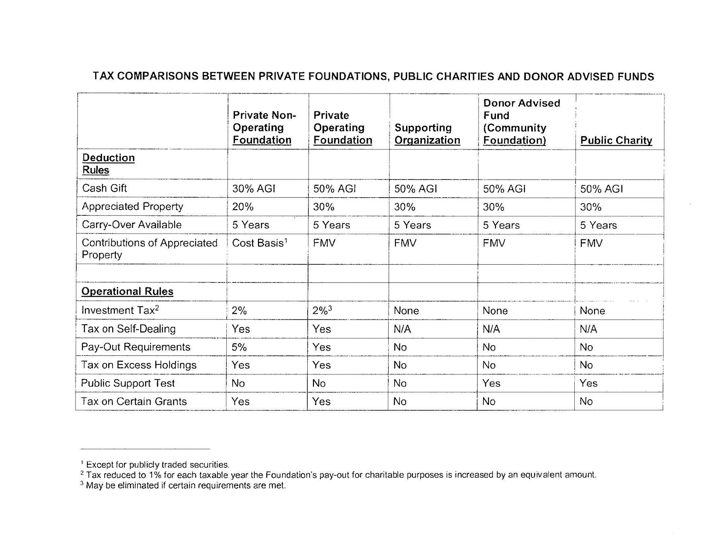

Slide 30
Other Community Foundation Vehicles
Field of Interest Fund
Donor indicates specific areas of interest
Fund makes grants to mission-aligned public charity grantees
DAF as corporate “foundation”
Established by corporation
Grants made in corporate name
Restricted Fund
Donors can support specific organizations through regular grants
Scholarship Funds
Donor can support students of any age, background or education level by selecting from different fund options

Slide 31
SYNERGIES – LET’S SOLVE SOME PROBLEMS

Slide 32
Case Study #1: 5% Payout
Facts:
Private foundation may not meet its 5% payout requirement
Why?
Time got away from them
Private foundation investments earned more than expected, so the 5% is a lot more than projected
Private foundation made big challenge grant to public charity. Late in the year, public charity notifies private foundation it can’t meet the challenge requirements

Slide 33
Case Study #1: 5% Payout
Solution:
Grant the 5% to a donor advised fund established by the foundation’s founders or directors
Allows flexible grant payout management
Avoids 30% penalty for failure to distribute 5%

Slide 34
Case Study #2: Integrating Family Board Members
Facts:
Long-term private foundation
When family members reach a certain age, they automatically become members of the board
New board members feel disenfranchised
Inability to approve grants by year-end

Slide 35
Case Study #2: Integrating Family Board Members
Solution:
Foundation sets up a DAF
Foundation makes 5% payout to DAF
Each board member advises on grants from a portion of the DAF

Slide 36
Case Study #2: Integrating Family Board Members
Result:
Avoids 30% excise tax for failure to distribute
Overcomes the feelings of disenfranchisement
Provides research and other programmatic support

Slide 37
Case Study #2: Structure
Individual Allocation
Individual Allocation
Individual Allocation
DAF: Common Pot
Individual Allocation
Individual Allocation
Individual Allocation

Slide 38
Case Study #3: Training and Ownership for Next Generation
Facts:
Parents created private foundation
Children serve on the board
Family as a whole approves grants
To control administrative burden, private foundation makes a few very large grants for Alzheimer’s research once a year

Slide 39
Case Study #3 – Training and Ownership for Next Generation
Children would also like to make smaller, more frequent grants to charities of interest to them.
Children see private foundation as their parents’. Parents’ goal was to have children feel it was theirs.

Slide 40
Case Study #3 – Training and Ownership for Next Generation
Solution:
Private Foundation establishes a DAF for each child and matches child’s DAF contributions 2 for 1.
Each child can make much smaller more frequent grants from the child’s DAF.
At the annual board meeting of the private foundation, parents and children discuss each child’s giving for the past year.

Slide 41
Case Study #4: Targeting Critical Needs Efficiently
Facts:
Jeff created a private foundation on his death
Closest friends and advisors comprise the board
Private foundation has $20,000 grant minimum

Slide 42
Case Study #4: Targeting Critical Needs Efficiently
Problem:
The private foundation wants to respond to funding requests from smaller high quality charities
Solution:
Private foundation makes $250,000 grant to field of interest fund at community foundation
Community foundation makes 25 grants of $10,000

Slide 43
Case Study #4: Targeting Critical Needs Efficiently
Community foundation’s existing grantmaking structure and process allow private foundation to fund small projects without changing its grant guidelines or increasing administration

Slide 44
Case Study #5: Anonymity Planning
Facts:
All private foundation grants are listed on its 990-PF tax returns, which are readily available online
Anyone can see the private foundation’s asset balance, directors and contact information

Slide 45
Case Study #5: Anonymity Planning
Problem:
A private foundation is not private at all. Unsolicited grant requests pour in. Investment advisors solicit directors for the private foundation’s business. Donors want privacy.

Slide 46
Case Study #5: Anonymity Planning
Solution:
Private foundation creates a DAF and makes its grants anonymously through the DAF. Community foundation tax returns must show all grants, but not what fund they came from.
All unsolicited grant applications are sent to community foundation for review and culling. The private foundation website makes clear that all discretionary giving is done through the community foundation.

Slide 47
Case Study #6: Complete Foundation Termination (one DAF)
Facts:
Family wants to completely terminate private foundation due to:
Loss of value in 2008 recession
Constraints on private foundations
Administrative burden

Slide 48
Case Study #6: Partial or Complete Foundation Termination
Solution:
Family establishes a DAF
Private foundation grants all of its assets to the DAF
Family members are DAF advisors
Private foundation terminates as an entity with no assets

Slide 49
Case Study #7: Complete Termination on Divorce (two DAFs)
Facts:
Parents created private foundation together many years ago
Size of foundation is around $1 million
Parents are divorcing
Problem:
Too expensive to split private foundation into two private foundations, one for each parent
Solution:
Terminate private foundation into two DAFs, one for each parent

Slide 50
Dissolving a Private Foundation into a DAF
Steps for dissolving a private foundation:
Board resolution
Letter to CA’s Attorney General requesting a waiver of objections to the dissolution and transfer
Wind-up affairs
File a Certificate of Dissolution
File a final financial report and RRF-1 form with the Attorney General
File final informational tax returns with the IRS and CA Franchise Tax Board
Notify IRS of dissolution

Slide 51
Case Study #8: Partial Foundation Termination: Maintaining Family Harmony
Facts:
Parents created private foundation long ago
Children and their spouses are directors
Problem:
All is well until daughter Ann marries a man all of the other children dislike
Ann and her husband become deeply involved with a cause outside the private foundation’s mission

Slide 52
Case Study #8: Partial Foundation Termination: Maintaining Family Harmony
Solution:
Partially terminate private foundation by distributing Ann’s share to a DAF, with Ann as fund advisor
Allows Ann to support her charitable causes and reduces intra-family tensions

Slide 53
Case Study #9: Complete Termination: Foundation Succession Planning
Facts:
Mom and dad, now in their 80s, created private foundation 40 years ago. It has meant a lot to them.
Their only son is not interested in the private foundation, and their friends are all their age.

Slide 54
Case Study #9: Complete Termination: Foundation Succession Planning
Solution:
Mom and dad terminate the foundation into a field of interest fund at a community foundation to support the same causes as the private foundation
The fund retains the private foundation’s name
The fund has a staffed, competitive application process to ensure grants are going to the best programs
The fund will last in perpetuity

Slide 55
Case Study #10: Charitable Lead Trust Gifts
Facts:
Max and Christine recently set up a charitable lead trust.
They wanted to set up a private foundation to receive the charitable lead payments.

Slide 56
Case Study #10: Charitable Lead Trust Gifts
Problem:
If Max and Christine, as directors of their private foundation, can vote on grants from the foundation of funds received from the charitable lead trust, the charitable lead trust assets will be in their estates for estate tax purposes. IRC Sec. 2036 control issue.

Slide 57
Case Study #10: Charitable Lead Trust Gifts
Solution:
Create a DAF with Max and Christine as fund advisors.
Because they retain only advisory powers, the lead trust will remain out of their estates.

Slide 58
Case Study #11: An Easier Way to Make International Grants
Facts:
Maria’s private foundation recently made a grant to a charity in Ethiopia.
Maria wants to continue to support foreign charities.
Problem:
It cost a lot in legal fees because of the due diligence required.
Maria needs a more efficient way to make grants to foreign charities.

Slide 59
Case Study #11: An Easier Way to Make International Grants
Solution:
Maria sets up a DAF.
Her private foundation makes grants to the DAF.
The community foundation has experience in and routines for conducting the due diligence on the foreign charity.

Slide 60
Case Study #12: Corporate Foundation Alternative
Facts:
Debbie and Ken own D&K, Inc., a manufacturing company
Once had plants in 5 states
Recession forced:
Closure of 2 plants
Layoffs of 17 corporate office employees

Slide 61
Case Study #12: Corporate Foundation Alternative
Goals:
Fund charitable foundation with low basis building that housed closed plant
Make grants into communities where plants closed
Establish employee charitable contribution $1-for-$1 matching program
Get a maximum tax benefit to D&K, Inc. for charitable contribution of the building

Slide 62
Case Study #12: Corporate Foundation Alternative
Challenges:
Scarce human resources to run corporate private foundation
Complexity/administrative burden of running employee matching program
Deduction for donation of building to private foundation limited to cost basis
If private foundation sells building, 2% or 1% excise tax on realized gain

Slide 63
Case Study #12: Corporate Foundation Alternative
Solution:
D&K, Inc. sets up a DAF
Company contributes building to DAF
Company gets deduction at FMV
Community foundation sells building; no excise tax on realized gains
Community foundation handles all investment management, compliance, administration and check distribution

Slide 64
Case Study #12: Corporate Foundation Alternative
D&K, Inc.’s Director of Community Affairs is DAF advisor and recommends grants into communities where plants closed
D&K, Inc.’s Director of Community Affairs is a primary contact for employee matching program
No additional D&K staff needed
Community foundation researches and provides advice on best local charities

Slide 65
Case Study #13: Scholarship Fund
Facts:
Jeff established a private foundation after selling his architectural firm.
First grant funded a scholarship in architecture at his alma mater.
Goal:
Create an architectural scholarship program for local college bound students, not limited to his alma mater.

Slide 66
Case Study #13: Scholarship Fund
Challenges:
Private foundation needs IRS pre-approval for scholarship plan
Self-dealing issues
Need private foundation administrator to:
Establish policies/guidelines
Publicize scholarships
Collect, review and cull applications
Coordinate recommendation letters/transcripts
Staff selection committee
Notify winners
Cut checks

Slide 67
Case Study #13: Scholarship Fund
Solution:
Establish scholarship fund at community foundation
Community foundation handles all administrative matters
Note: Donor cannot participate in selection committee through private foundation or community foundation but can meet, mentor and/or track the progress of scholarship recipients

Slide 68
Case Study #14: The Donor’s Trusted Investment Advisor
Facts:
Ann-
Has done well financially
Is loyal to her trusted investment advisor of 20 years
Is concerned a community foundation will not manage her donated funds as well
Wants to support a soup kitchen which is new but very successful

Slide 69
Case Study #14: The Donor’s Trusted Investment Advisor
Ann-
Opens a restricted fund at the community foundation
Donates at least $500,000
Specifies all income gets paid to soup kitchen in quarterly installments

Slide 70
Case Study #14: The Donor’s Trusted Investment Advisor
Advisor manages investment of 95% of Ann’s fund assets
Community foundation provides broad philanthropic support
Soup kitchen has the benefit of an endowment but doesn’t have the $500,000 on its balance sheet (which could impede fundraising)
If soup kitchen terminates, Ann can redirect her restricted fund to one or more similar organizations.

Slide 71
Valuable Community Foundation Custom Services
One on one conversations with family foundation board members to discern their personal grantmaking interests and to provide feedback on the mission and direction of the family foundation
Vetting and research of potential organizations of choice
Presentation to the family foundation board on the aggregate findings of the interview process
Compilation of board meeting materials, both in electronic and hard copy
Suggestions of decision making models for the family to consider as they vote on grants
Drafting, execution and monitoring of grant agreements, including measurable outcomes tied to funding, along with reporting due dates and requirements

Slide 72
When considering whether a client should have a private foundation or other type of philanthropic fund or entity, the best answer may be “both”

